Slide 1
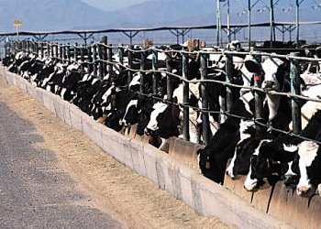
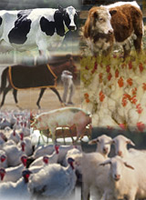
Watershed Groups and Confined Feeding Operations: Bridging the Gap
Ryan Noblitt
Joe Schmees

Slide 2
Our vision was to create a “fact-versus-fiction” presentation about CAFOs/CFOs for watershed groups. Our hope is that it will help watershed groups better understand these confined feeding livestock farms, while assisting them to devise a strategy to bring them to the table when addressing watershed concerns

Slide 3
What lead us to this topic?
CAFO/CFO operation is a major concern for watershed groups
Location and increasing number of CAFOs/CFOs is a highly politicized, “hot” topic
People tend to immediately “point fingers” at CAFOs/CFOs as a source of pollution
Although citizens tend to be upset about CAFOs/CFOs, they may not understand how they operate or are regulated

Slide 4
Organizing our thoughts
What we don’t want…
To pass off our opinion as fact
To “pick a side” in the controversy
To provide incorrect information
What we want…
To provide information on CAFO/CFO operation
To provide information of CAFO/CFO regulation
To provide ways a watershed group can get involved in the discussion
To assist in providing the facts so stakeholders are educated

Slide 5
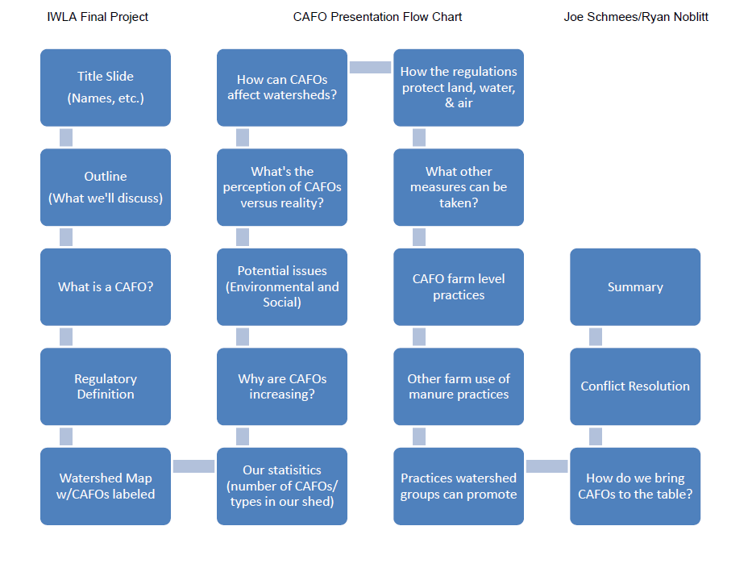

Slide 6
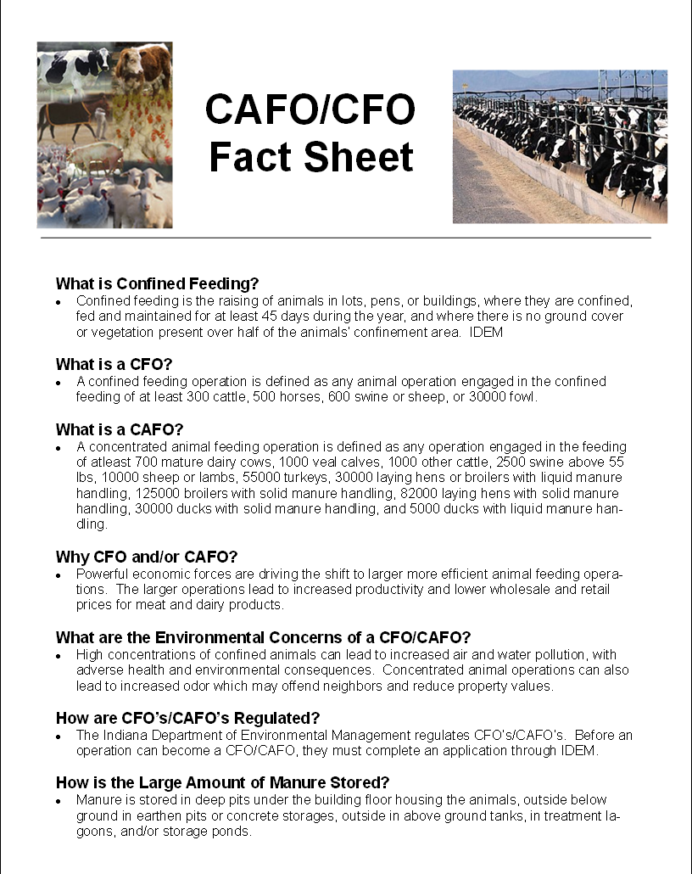

Slide 9
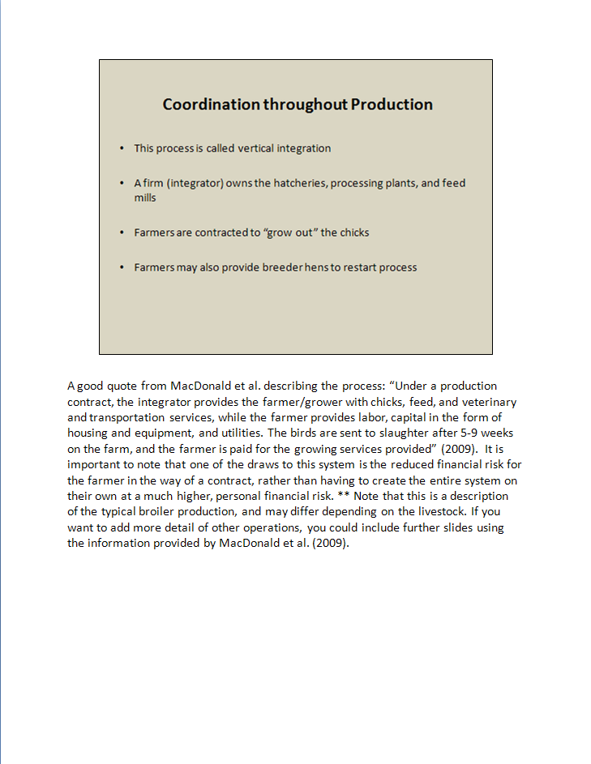

Slide 11
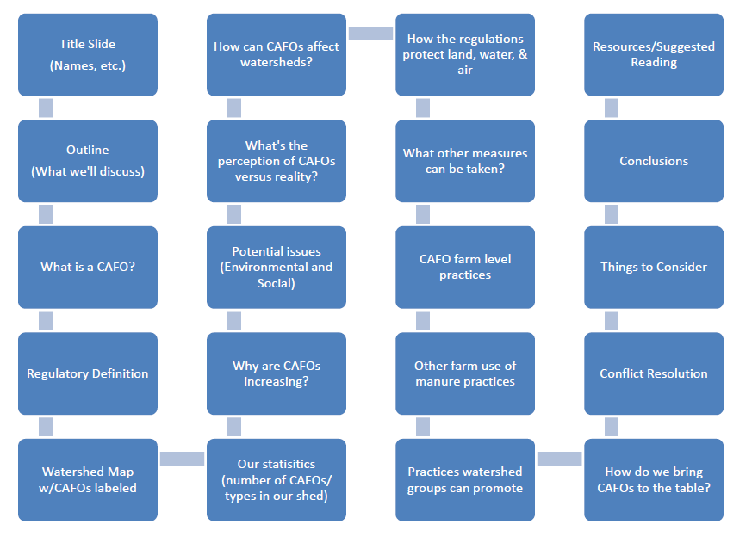

Slide 12
Things to Consider
There is SO much info out there, we can’t include it all!
Reading the CAFO/CFO rule and other resources is important before presenting to others!
This presentation is a building block or template… watershed groups need to make it there own!
Add slides
Add resources
This is just a beginning!
Our presentation and fact sheet are not static… they need to be updated as rules change and new technology created.

Slide 13
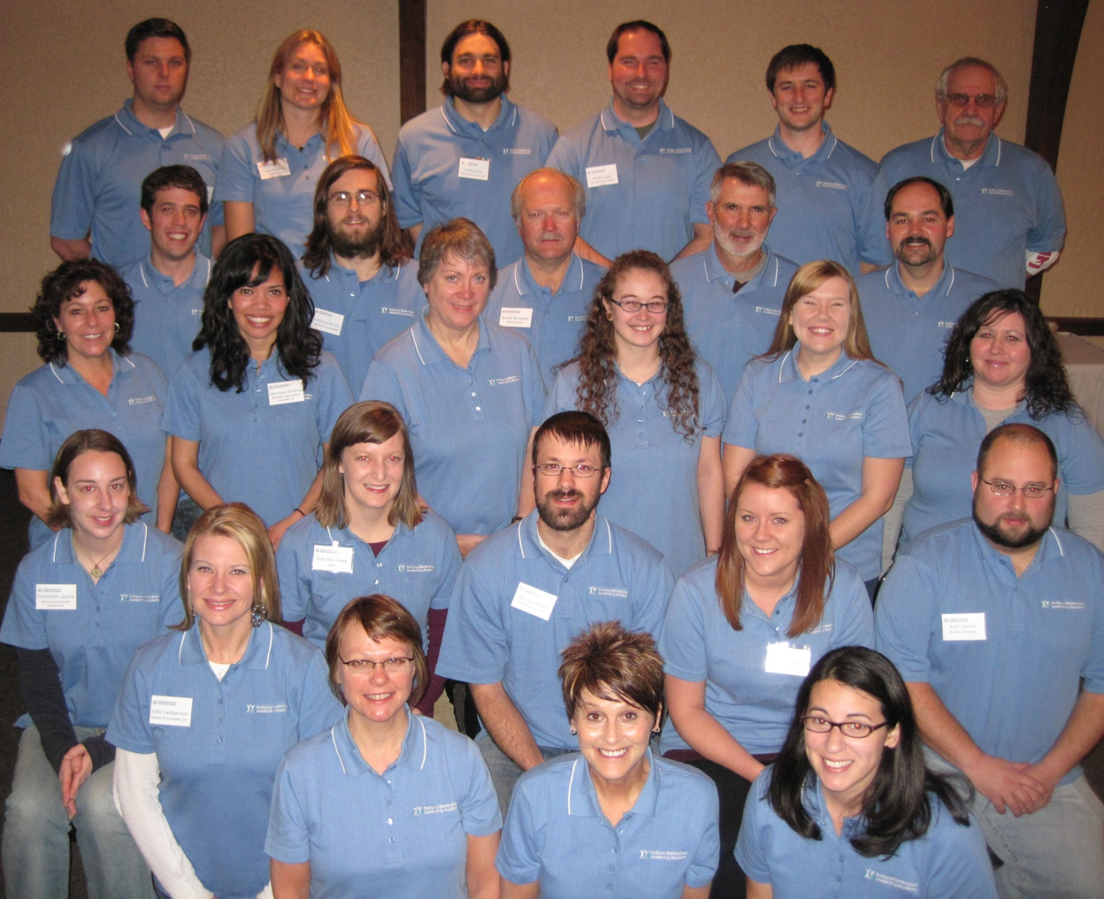
QUESTIONS?

